Slide 1



History of Water Reuse in Texas
Alan H. Plummer, Jr., P.E., BCEE
Ellen T. McDonald, Ph.D., P.E.
Alan Plummer Associates, Inc.

Slide 2
Water Reuse Terminology

Slide 3
Direct Reuse
5
Industrial
Users
Wastewater
Treatment Plant
Irrigation
Users
Community
WTP (Future potential)
Stream
(Environmental Flows)

Slide 4
6
Indirect Reuse
Wastewater
Treatment
Plant
Water
Treatment
Plant
Community
Stream
(Environmental Flows)

Slide 5
Historical Perspectives

Slide 6
Evolution of
Reuse in Texas
?
Direct Potable
Indirect Potable
Planned
Unplanned
Municipal
Industrial
Agricultural

Slide 7
Early Agricultural Reuse
San Antonio (1890s)
Amarillo (1920s)
Lubbock (1930s)
Odessa (1940s)
Abilene (1960s)
Notes:
Add graphics

Slide 8
Early Industrial Reuse
Big Spring- Cosden Oil Refinery (1940s)
Odessa- Petrochemical plant (1950s)
Amarillo- Texaco Refinery (1950s)
San Antonio- Power plant cooling water (1960s)
Lubbock- Power plant cooling water (1970s)
Notes:
Add graphics (if can fit some)

Slide 9
Early Municipal Nonpotable Reuse
El Paso (1960s)
Odessa (1980s)
Trinity River Authority/Dallas County Utility Reclamation District (1980s)
Abilene (1990s)
San Antonio (2000)
Notes:
Add graphics (if can fit some)

Slide 10
City of Odessa
TXDOT
Bob Derrington
Water Reclamation Plant
University
Parks
Golf Courses
Residential
Irrigation

Slide 11
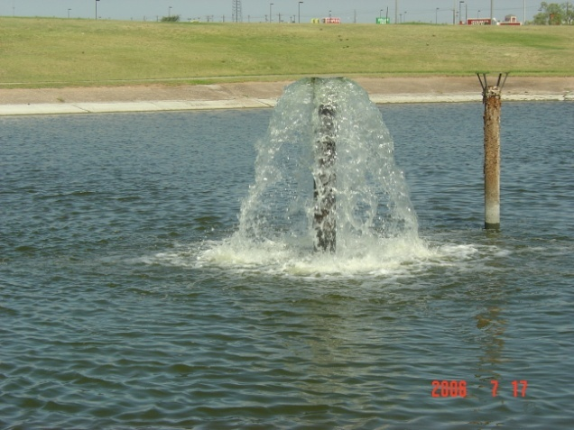
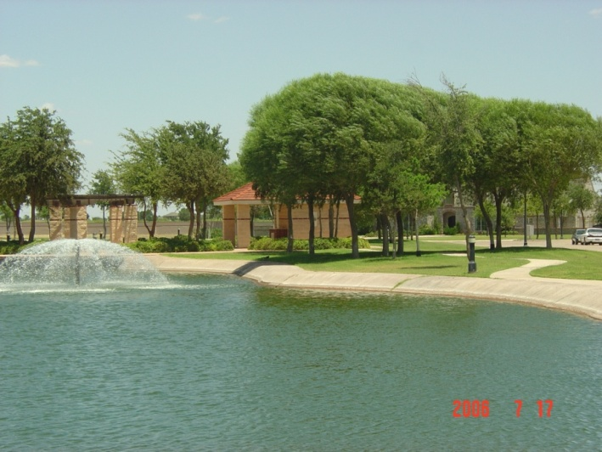
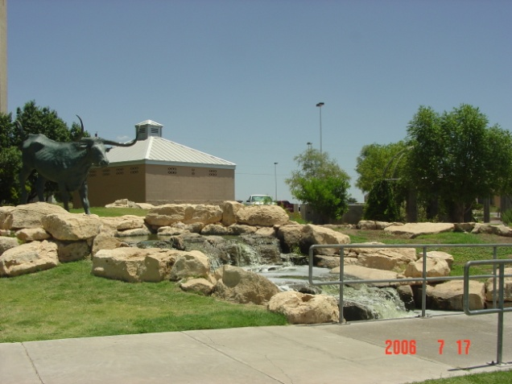
City of Odessa
UTPB Park
Vista La Paz Residential Area
Memorial Garden

Slide 12
TRA/DCURD Las Colinas Reuse Project
TRA CRWS WWTP
Elm Fork
LCCC
Detention Pond
LCSC
Landscaping
HCCC

Slide 13
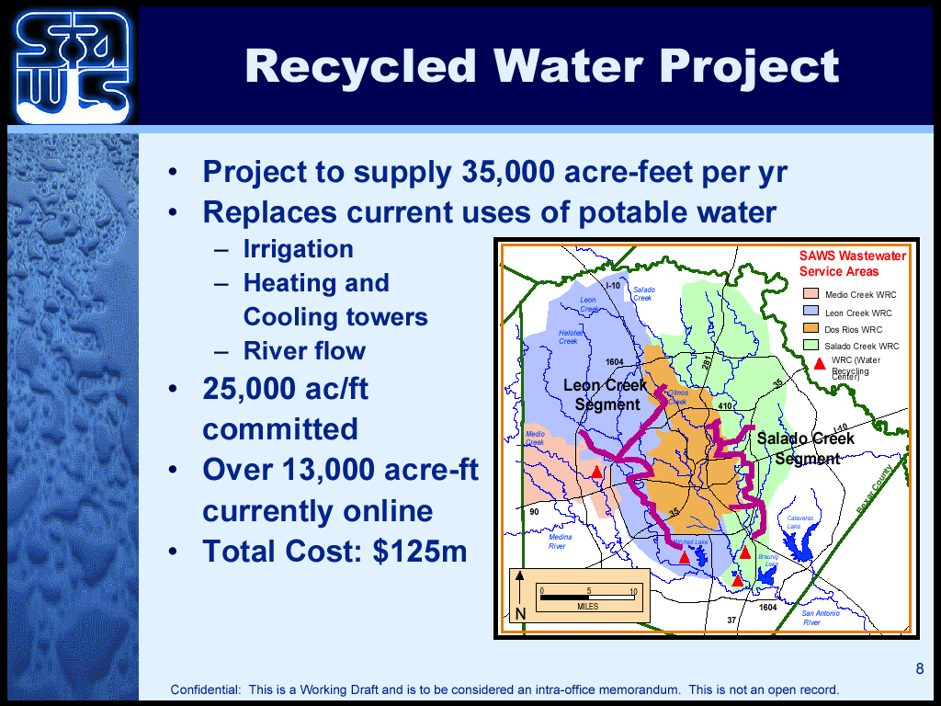

Slide 14
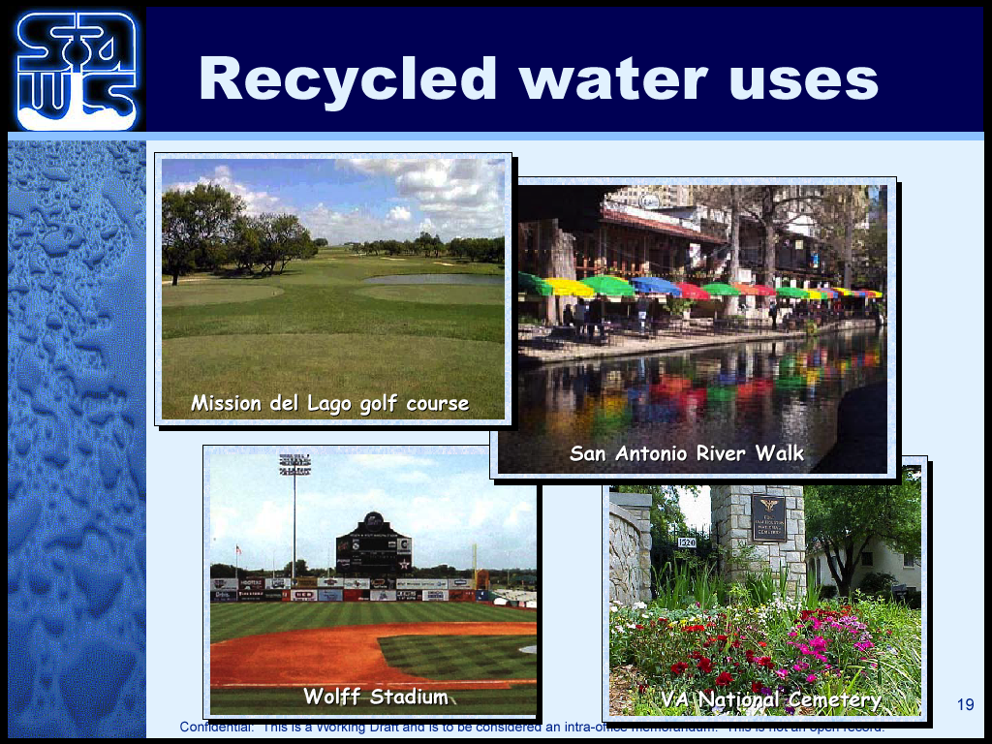

Slide 15
Unplanned Indirect Potable Reuse
Numerous discharges into water supply reservoirs (Note: Agreement executed that requires discharges)
Additional discharge into streams that serve as water supply sources

Slide 16
Planned Indirect Potable Reuse
Texas has been a leader in the implementation of planned indirect reuse
Some Examples:
  El Paso (groundwater)
  Tarrant Regional Water District (surface water)
  North Texas Municipal Water District (surface water)
Notes:
Add wetland picture

Slide 17
Historical Influence on Water Reuse
Planning (population, water demands, droughts, etc.)
Regulations (water rights and water quality)
Efficient use of water (conservation)
Research

Slide 18
Planning
Regional and state water supply planning
Local water reuse planning

Slide 19
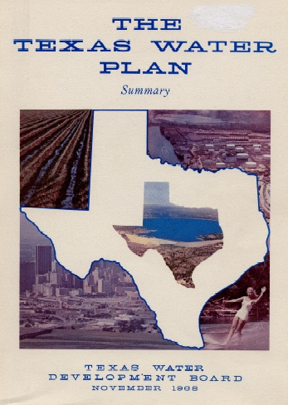
1968 State Water Plan
Return flows are…“an essential and valuable water resource that should be managed and administered conjunctively with other water resources”
Notes:
First official state water plan under TWDB- recognized return flows as important resource.

Slide 20
Regional and State Water Supply Planning
Senate Bill 1 (1997)
  16 regional water supply plans
    Senate Bill 2 (2001) and Senate
  Bill 3 (2007)
  16 regional water supply plans (continued)
  Additional emphasis on environmental flows

Slide 21
Role of Water Reuse

Slide 22
Conservation and Reuse by Planning Region
New Supplies (ac-ft/yr)
Source: Texas Water Development Board, Water for Texas 2007

Slide 23
Texas New Water Supply Strategies
ac-ft/y
Source: Texas Water Development Board, Water for Texas 2007

Slide 24






Water for Texas 2007
New Water Supplies- Statewide
Existing Reservoirs | 37%
Groundwater | 9%
New Reservoirs | 12%
Reuse | 14%
Municipal Conservation | 7%
Agricultural Conservation | 15%
Desalination | 4%

Slide 25
Regulatory
Direct reuse
  TAC Chapter 210 (1997)
Indirect reuse
  Surface water quality standards
    TDS
    Nutrient standards
  Water right permitting
    Instream/environmental flows

Slide 26
Chapter 210 Authorizations Issued

Slide 27
TWCA Reuse Committee White Paper Regarding Texas Water Rights and Wastewater Reuse ⁽¹⁾
Basic Legal Background
Identifies Disputed Issues
Summarizes Arguments Regarding Issues
Potential Consequences of Policy Alternatives
⁽¹⁾ www.twca.org/waterissues.html

Slide 28
Efficient Use of Water
(Water Conservation)

Slide 29
Water Conservation and Reuse Considerations
Conservation Task Force Actions
  Developed Best Management Practices for conservation
  Recognized reuse as a conservation strategy (Note: State law recognizes reuse as a form of conservation.)
  Established voluntary target of 140 gpcd after credit for reuse
Interbasin transfers require “Highest practicable levels of water conservation and efficiency achievable”

Slide 30
Research
Historical TWDB Supported Research
TWDB Development of Research Agenda to aid in implementation of reuse projects (November 2010)

Slide 31
Challenges to Advancing Water Reuse

Slide 32
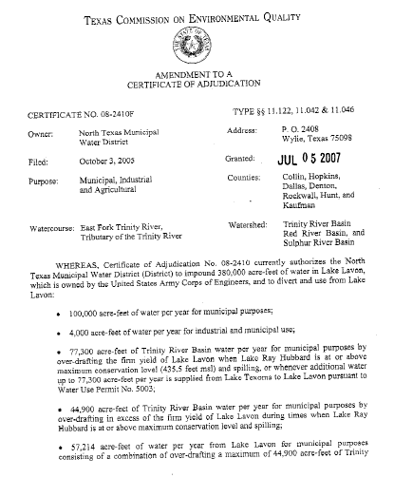
Challenge No. 1
Water Rights
  Balance between ecological and human needs

Slide 33
Challenge No. 2
Water quality issues
  Emerging constituents (pharmaceuticals, personal care products, etc.)
  Total dissolved solids
  Treatment requirements
  Regulatory drivers

Slide 34
Challenge No. 3
FUNDING, FUNDING, FUNDING!

Slide 35
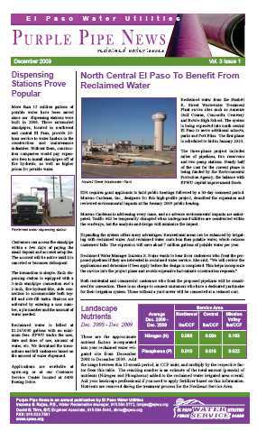
Challenge No. 4
Public outreach and awareness

Slide 36
Conclusion
Texas has a successful history of beneficially using reuse water
Advance of reuse water is dependent upon collaboration of stakeholders to address the challenges

